Slide 1
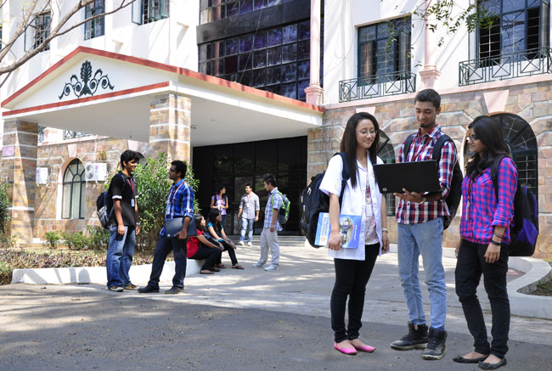

B.Tech Computer Science and Engineering – Vth Semester
Theory of Computation
Department of Computer Science and Engineering

Slide 2
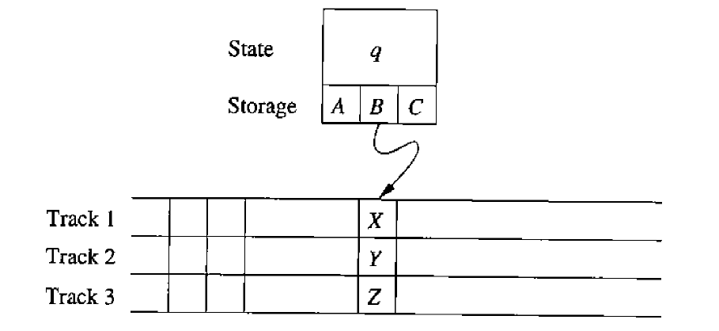
Turing Machine with storage states
Q is finite states.
A,B,C are memory storages.
Here the states are considered to be a combination of states and storage.

Slide 3
The TM with memory is represented by
M=(Q,{0,1}, {0,1,B}, δ, [q0,B],{[q1,B]})
The set Q is {q0,q1} x {0,1,B}
The control portion is q0,q1 now it is combined with memory
We consider the language 01*+10* - we need to remember what symbol has been read first.

Slide 4
The transition functions are
δ([q0,B],a)=([q1,a],a,R) for a=0 or a=1
δ([q1,a],a’)=([q1,a],a’,R) where a’ is the complement of a.
δ([q1,a],B)=([q1,B],B,R) for a=0 or a=1, if M reaches the blank in the input.

Slide 5
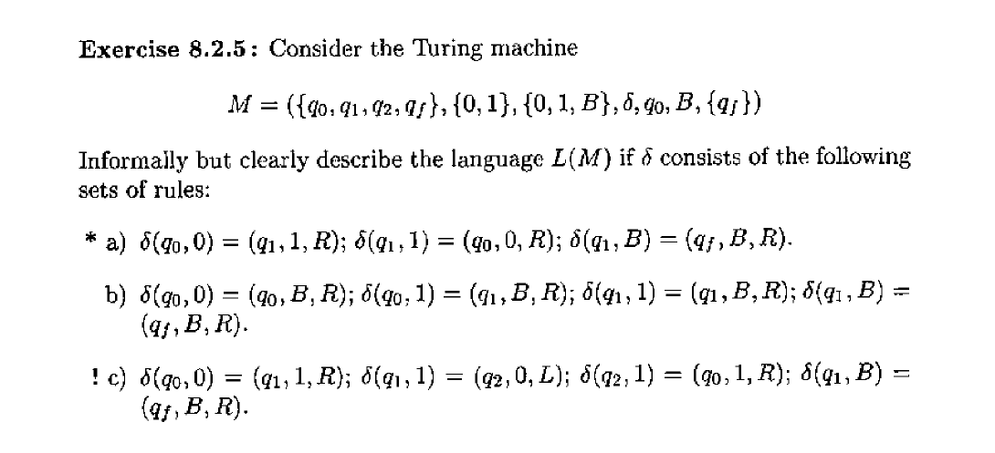

Slide 6
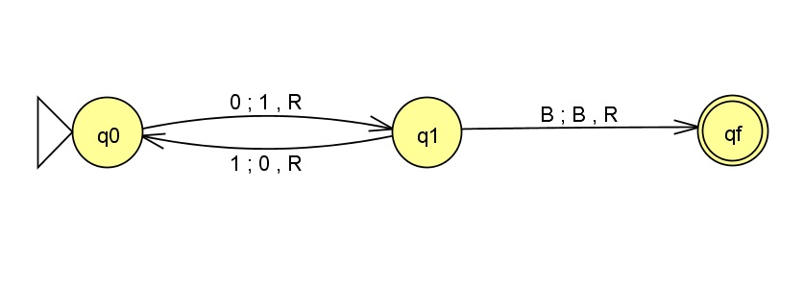
Solution for Exercise Examples 1
L={0,010,01010,0101010,…….}
0(10)*
q₀010 Ⱶ 1q₁10 Ⱶ10q₀0 Ⱶ 101q₁B Ⱶ 101Bq_{f} --- accepted

Slide 7
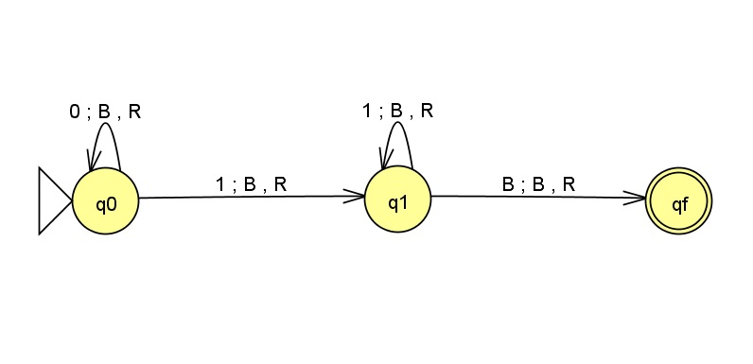
Solution for Exercise Examples 1
0*11*
L={1,01,001,111,000111,00000111,……..}

Slide 8
TM with Multiple Tapes
Here TM consists of several tracks, Each track can hold one symbol
The Head of the finite state is still one and the tape symbols it reads on the diagram will be [X,Y,Z].
The common use of multiple tracks is one track holding data as usual and other holds the marking.
Remember in the 0^{n}1^{n} case we converted the 0s and 1s into X and Y so that we can identify the difference between the symbols which are read and the symbols which are yet to be read. If we have a marking we shall not convert the inputs into X or Y, instead juts mark them read.

Slide 9
TM with Multiple Tapes
Let is consider the language
L_{wcw}={wcw | w is in (0+1)⁺}
The TM will be represented as M=(Q,∑, Γ, δ,[q1,B],[B,B],[q9,B]}
The set of states Q= {q1,q2,…a9} x {0,1,B}
The set of tape symbols Γ = {B,*} x {0,1,c,B}
In tape1 cells can be either Blank(B) or checked (*)
In tape2 cells holds the normal input.
The input symbols ∑ [B,0] [B,1]

Slide 10
TM with Multiple Tapes
The δ of the functions will be
Every transition watch the state movement
δ([q1,B],[B,a]) = ([q2,a],[*,a],R) – initially M picks up the symbol a and stores it in the tape.
δ([q2,a],[B,b]) = ([q2,a],[B,b],R) – M keeps moving to the right here marking is not done for the input symbols so it is left as B.
δ([q2,a][B,c]) = ([q3,a][B,c],R) – After reading c the middle component of the input M moves to a new state and c is not marked, head keeps moving to the left.
δ([q3,a][*,b])= ([q3,a][*,b],R) – after c the head keeps moving to the right ignoring all the already marked inputs.

Slide 11
The δ of the functions will be
5. δ ([q3,a][B,a]) = ([q4,B],[*,a],L) this is the first unchecked symbol so it is checked and the head starts moving to the left. Look at the input alog with state q3 and the current input is same and hence it is matched and marked.
6. δ([q4,B],[*,a])= ([q4,B],[*,a],L) M moves to the left leaving all the marked symbols.
7. δ[q4,B],[B,c]) = ([q5,B],[B,c],L) M have moved past the centre mark c and hence we move to q5.
8. δ([q5,B],[B,a])=([q6,B][B,a],L) M identifies a unchecked symbol to the left of c. δ([q6,B][B,a])=([q6,B][B,a],L) M keep on moving to left until it finds the left most unchecked input symbol.

Slide 12
The δ of the functions will be
9. δ([q6,B][*,a])=([q1,B],[*,a],R) M finds the marked symbol to the left of c(the immediate right symbol should be unchecked) here we have to restart the process once again from q1.
10. δ([q6,B][*,a])=([q1,B],[*,a],R) here we check the symbol that is unchecked and startover again from q1
11. δ([q5,B][*,a]) = ([q7,B][*,a]),R) this is a branch for the case of all symbols to the left of c is checked.
12. δ([q7,B],[b,c])= ([q7,B],[b,c],R) the immediate next should be c and M moves on to right.
13. δ([q8,B],[8,a])= ([q8,B],[8,a],R) M skips all the marked symbols to the right of c.
14. δ([q8,B],[B,B])= ([q9,B],[B,B],R) here M reached the right most end of the input and moves and hence finds B. This is the halting condition.

Slide 13
Thank You .. Have a Great Day

